Slide 1
Proteomics
Systems Biology of Human Metabolism and Gut Microbiome 1 Nov 2021

Slide 3
Systems Biology in hepatology
Mardinoglu et. al (2018), Nature Reviews Gast & Hep, 2018

Slide 4
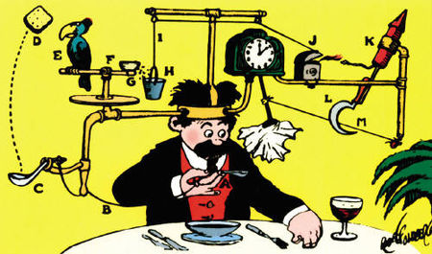
Systems Biology & Systems Medicine
Evolution created enormously complicated organisms and this random and chaotic process only work in particular environment.
Over the years complicated circuits are built on top of this complex structure.
To study and understand this complexity is a challenging task.
Rube Golberg’s inventions
Number of components
Individual dynamics
Their connection
System dynamics
4

Slide 5
What is proteomics?
Definition – Large-scale study of proteins
In daily use – Studying a protein sample using mass spectrometry

Slide 7
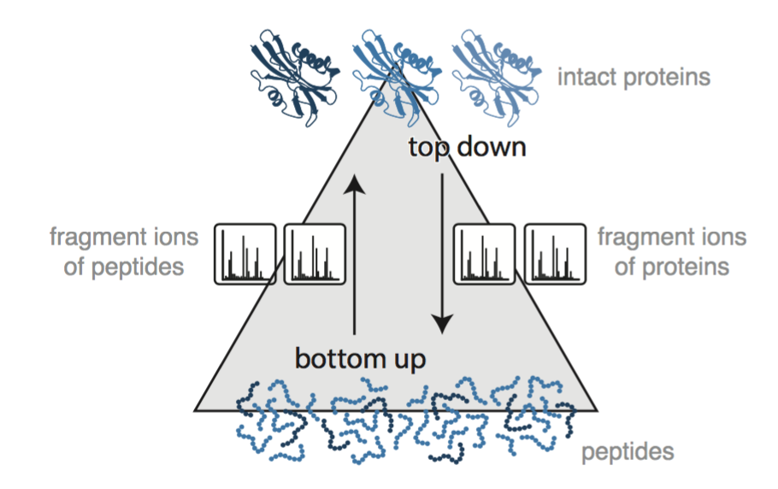
Mass spectrometry-based proteomics
Top down proteomics
Analysis of intact proteins
Complicated MS data analysis
Bottom up proteomics
Peptides released by enzymatic degradation
Measures peptide-ions and their fragmentation patterns
By far the most used approach in proteomics
Quantitative shotgun proteomics: considerations for a high-quality workflow in immunology Felix Meissner & Matthias Mann Nature Immunology
Notes:
Top-down
Analyses intact proteins and map protein fragment spectra to protein sequences.
Bottom-up
Analyses peptides from hydrolysed proteins and map peptide spectra to protein sequences to infer their presence.

Slide 8
Different proteomics approaches
Data-dependent acquisition proteomics (DDA or Shotgun)
No prior knowledge needed
MS1 quantification
Data-independent acquisition proteomics (DIA or SWATH)
Needs spectral libraries
MS2 quantification
Targeted proteomics (SRM, MRM, PRM, HR-MRM etc.)
Needs assay development
Generally hypothesis driven
MS2 quantification
Quantitative shotgun proteomics: considerations for a high-quality workflow in immunology Felix Meissner & Matthias Mann Nature Immunology
Notes:
Top-down
Analyses intact proteins and map protein fragment spectra to protein sequences.
Bottom-up
Analyses peptides from hydrolysed proteins and map peptide spectra to protein sequences to infer their presence.

Slide 9
Protein identification in shotgun proteomics
Protein digestion into peptides
Peptide separation using liquid chromatography
Electrospray ionization
Full scan of peptide ions (MS1)
Selection of the most intense peptide ions to fragment and analyze (MS2)
Fragment ion spectra are used for peptide identification
Protein quantification based on peptide ion intensity (MS1 level)
Kacerovsky et al (2015) Proteomic Biomarkers for Spontaneous Preterm Birth: A Systematic Review of the Literature

Slide 10
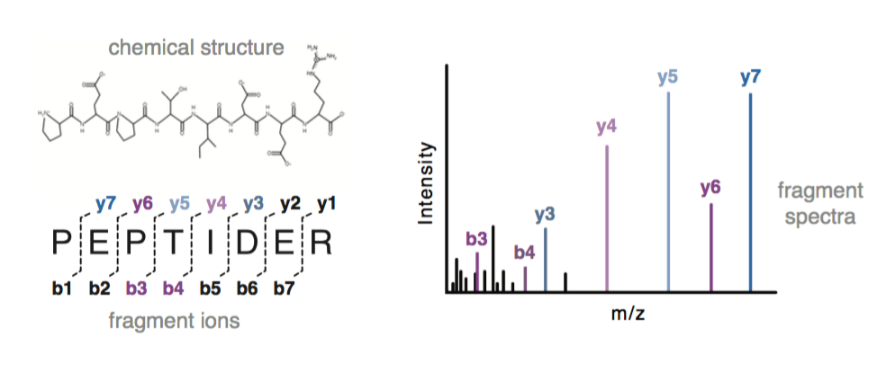
Peptide fragmentation
Peptide ion fragmentation
Peptide ion isolation
Collision with inert gas
Fragmentation pattern
Based on sequence
Depends on collision energy
Peptide identification
Precursor mass
Fragmentation pattern
Match to data base

Slide 11
Data analysis in shotgun proteomics
Dedicated software and search algorithms (vendor specific and free software)
Load raw data files
Detect peptide peaks
Match peptide fragmentation spectra against a data base
Perform some kind of peptide/protein quantification
Produce table of identified (and quantified) peptides or proteins
Matching peptide spectra
Choose database to match against (species, subset of proteins)
Choose your acceptable false discovery rate (FDR, typically 1%)
Protein quantification
Choose quantification method (label free, isobaric tags, stable isotopes)
Unique peptide → Protein ID

Slide 12
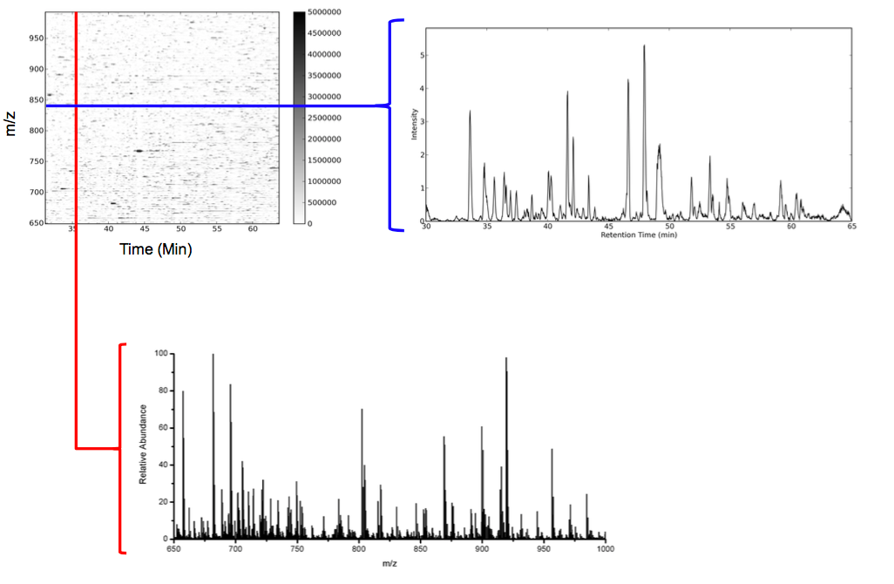
Proteomes are Dynamic and Complex
Extracted ion chromatogram (XIC):
Looking at a specified m/z over time
Mass spectrum (full scan):
Signals for all m/z at a certain time
Mike McCoss
Notes:
Horizontal: One peptide m/z over time (extracted ion chromatogram)
Vertical: One mass spectrum at a certain time point

Slide 13
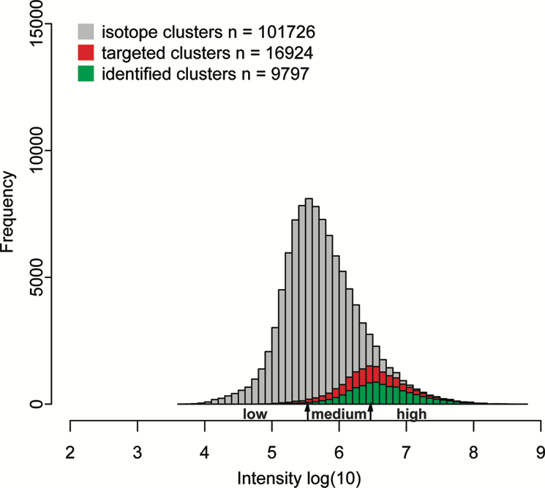
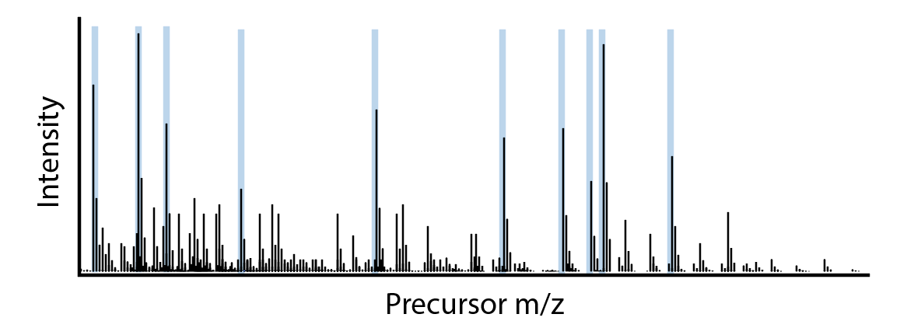
Data Dependent Acquisition will Always Under Sample
Isotope clusters identified from a shotgun experiment

Slide 14










How well does shotgun proteomics describe a sample?
Imagine visiting Kyoto (Japan) and visiting the tallest buildings first
Analogy Nathan Yates / Mike McCoss

Slide 15





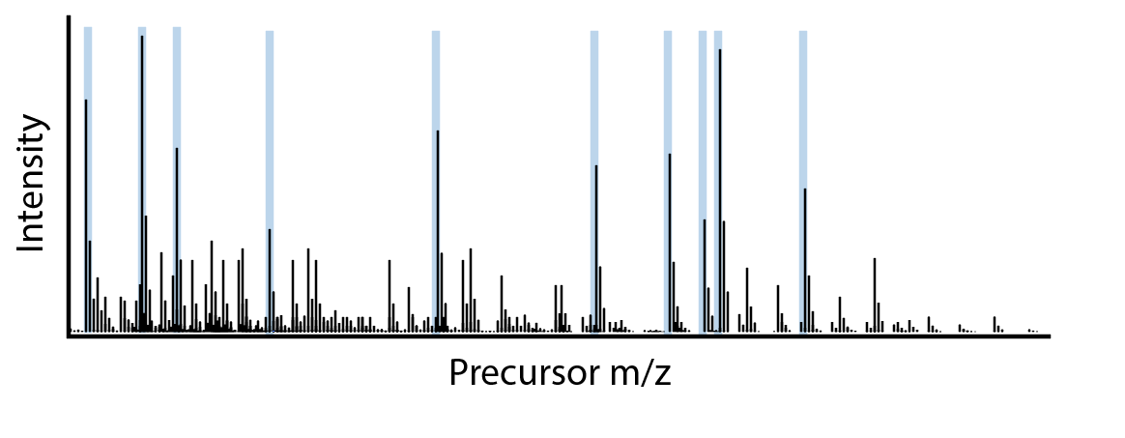
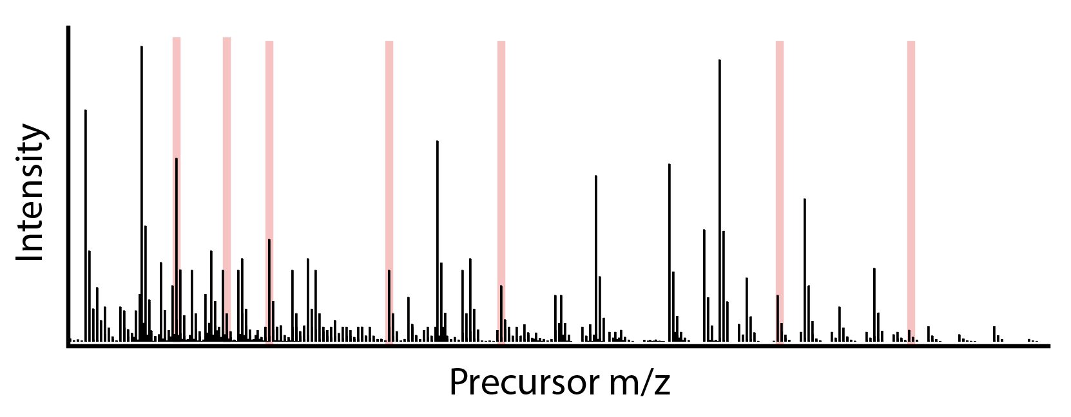
How well does shotgun proteomics describe a sample?
Imagine visiting Kyoto (Japan) and visiting the tallest buildings first
Analogy Nathan Yates / Mike McCoss

Slide 16
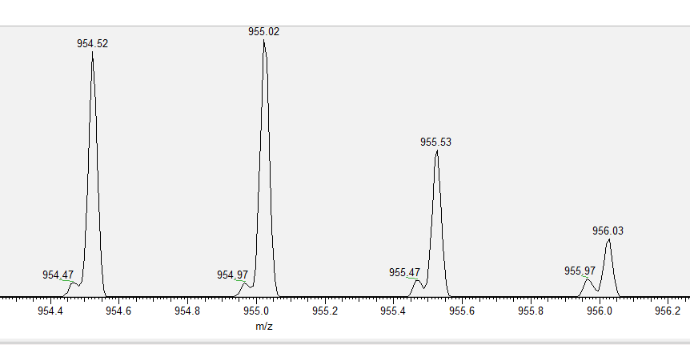
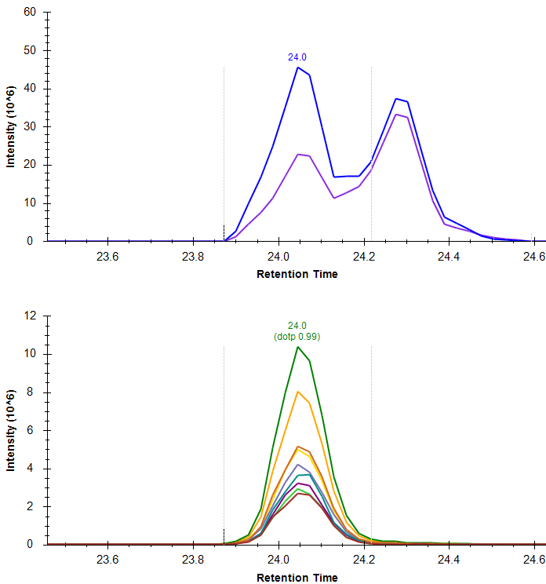
Interference
M M+1 M+2 M+3
MS1
MS2
M: monoisotopic mass

Slide 17
Limitations with shotgun proteomics
“Semi-random” sampling for peptide fragmentation and identification
Data sets with missing values
Favors detection and quantification of high abundant proteins -> low sensitivity
MS1 quantification generally less accurate than MS2 quantification

Slide 18
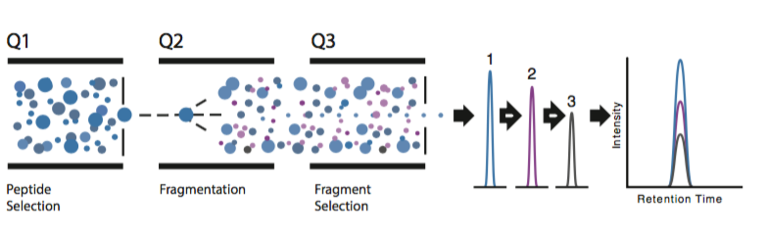
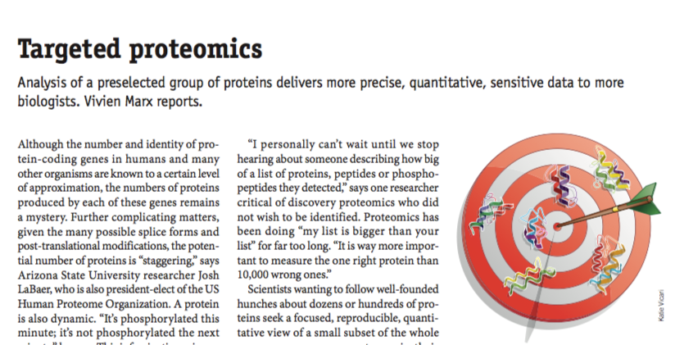
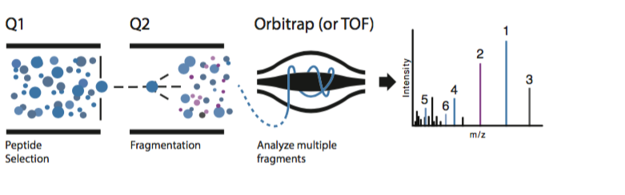
Targeted Proteomics
Selected Reaction Monitoring (SRM)/Multiple Reaction Monitoring (MRM)
Parallel Reaction Monitoring (PRM)

Slide 19
Targeted Proteomics
Benefits
Data for the same peptides are recorded in every run
More consistent data
Easier to compare between samples (e.g. case / control)
Drawbacks
Peptides has to be well characterized
Ionization
Retention time
Fragmentation
Tedious assay development
Only provides data on a limited number of peptides

Slide 20
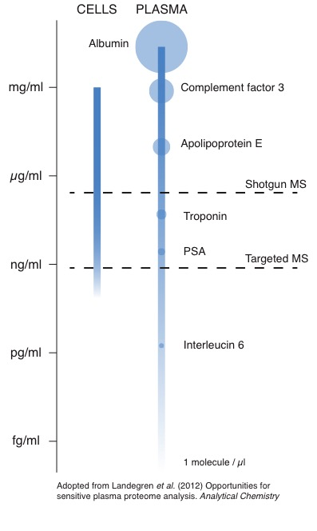
Targeted proteomics vs. shotgun proteomics
Shotgun proteomics
Variable sampling of peptides for fragmentation – Replicate injections can detect different peptides
Quantification on MS1-level (peptide ions)
Generally used in discovery studies
Limited sensitivity
Targeted proteomics
Predefined list of peptides to fragment – Good reproducibility
Quantification on MS2-level (fragment ions)
Generally used for verification of an hypothesis
Higher sensitivity
Interleukin 6

Slide 21
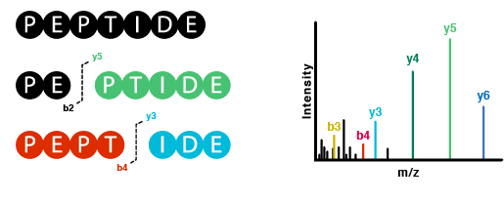
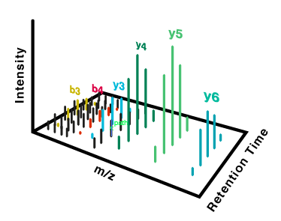
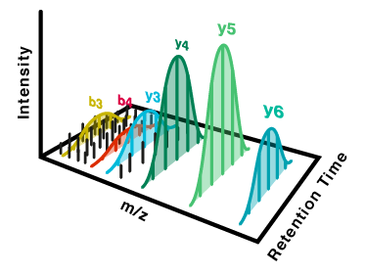
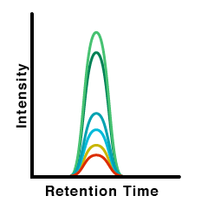
Chromatographic Peak Extraction
Quantification of one peptide analyzed in PRM

Slide 22
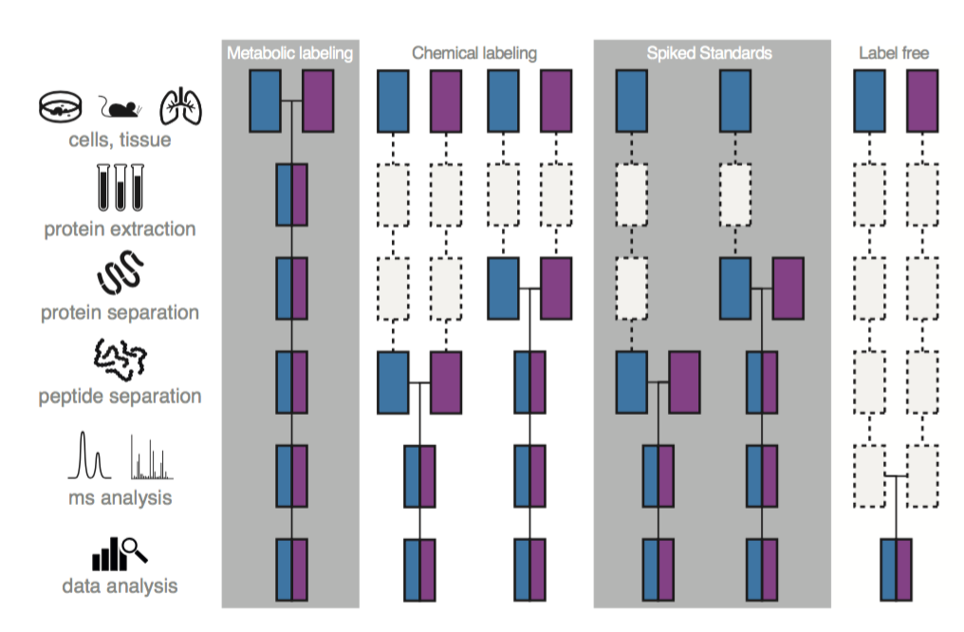
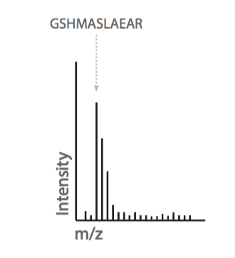
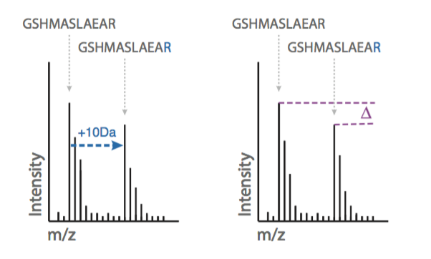
MS-based Peptide Quantification
Label Free
Stable isotopes
Metabolic labeling
Chemical labeling
Spiked Standards

Slide 23
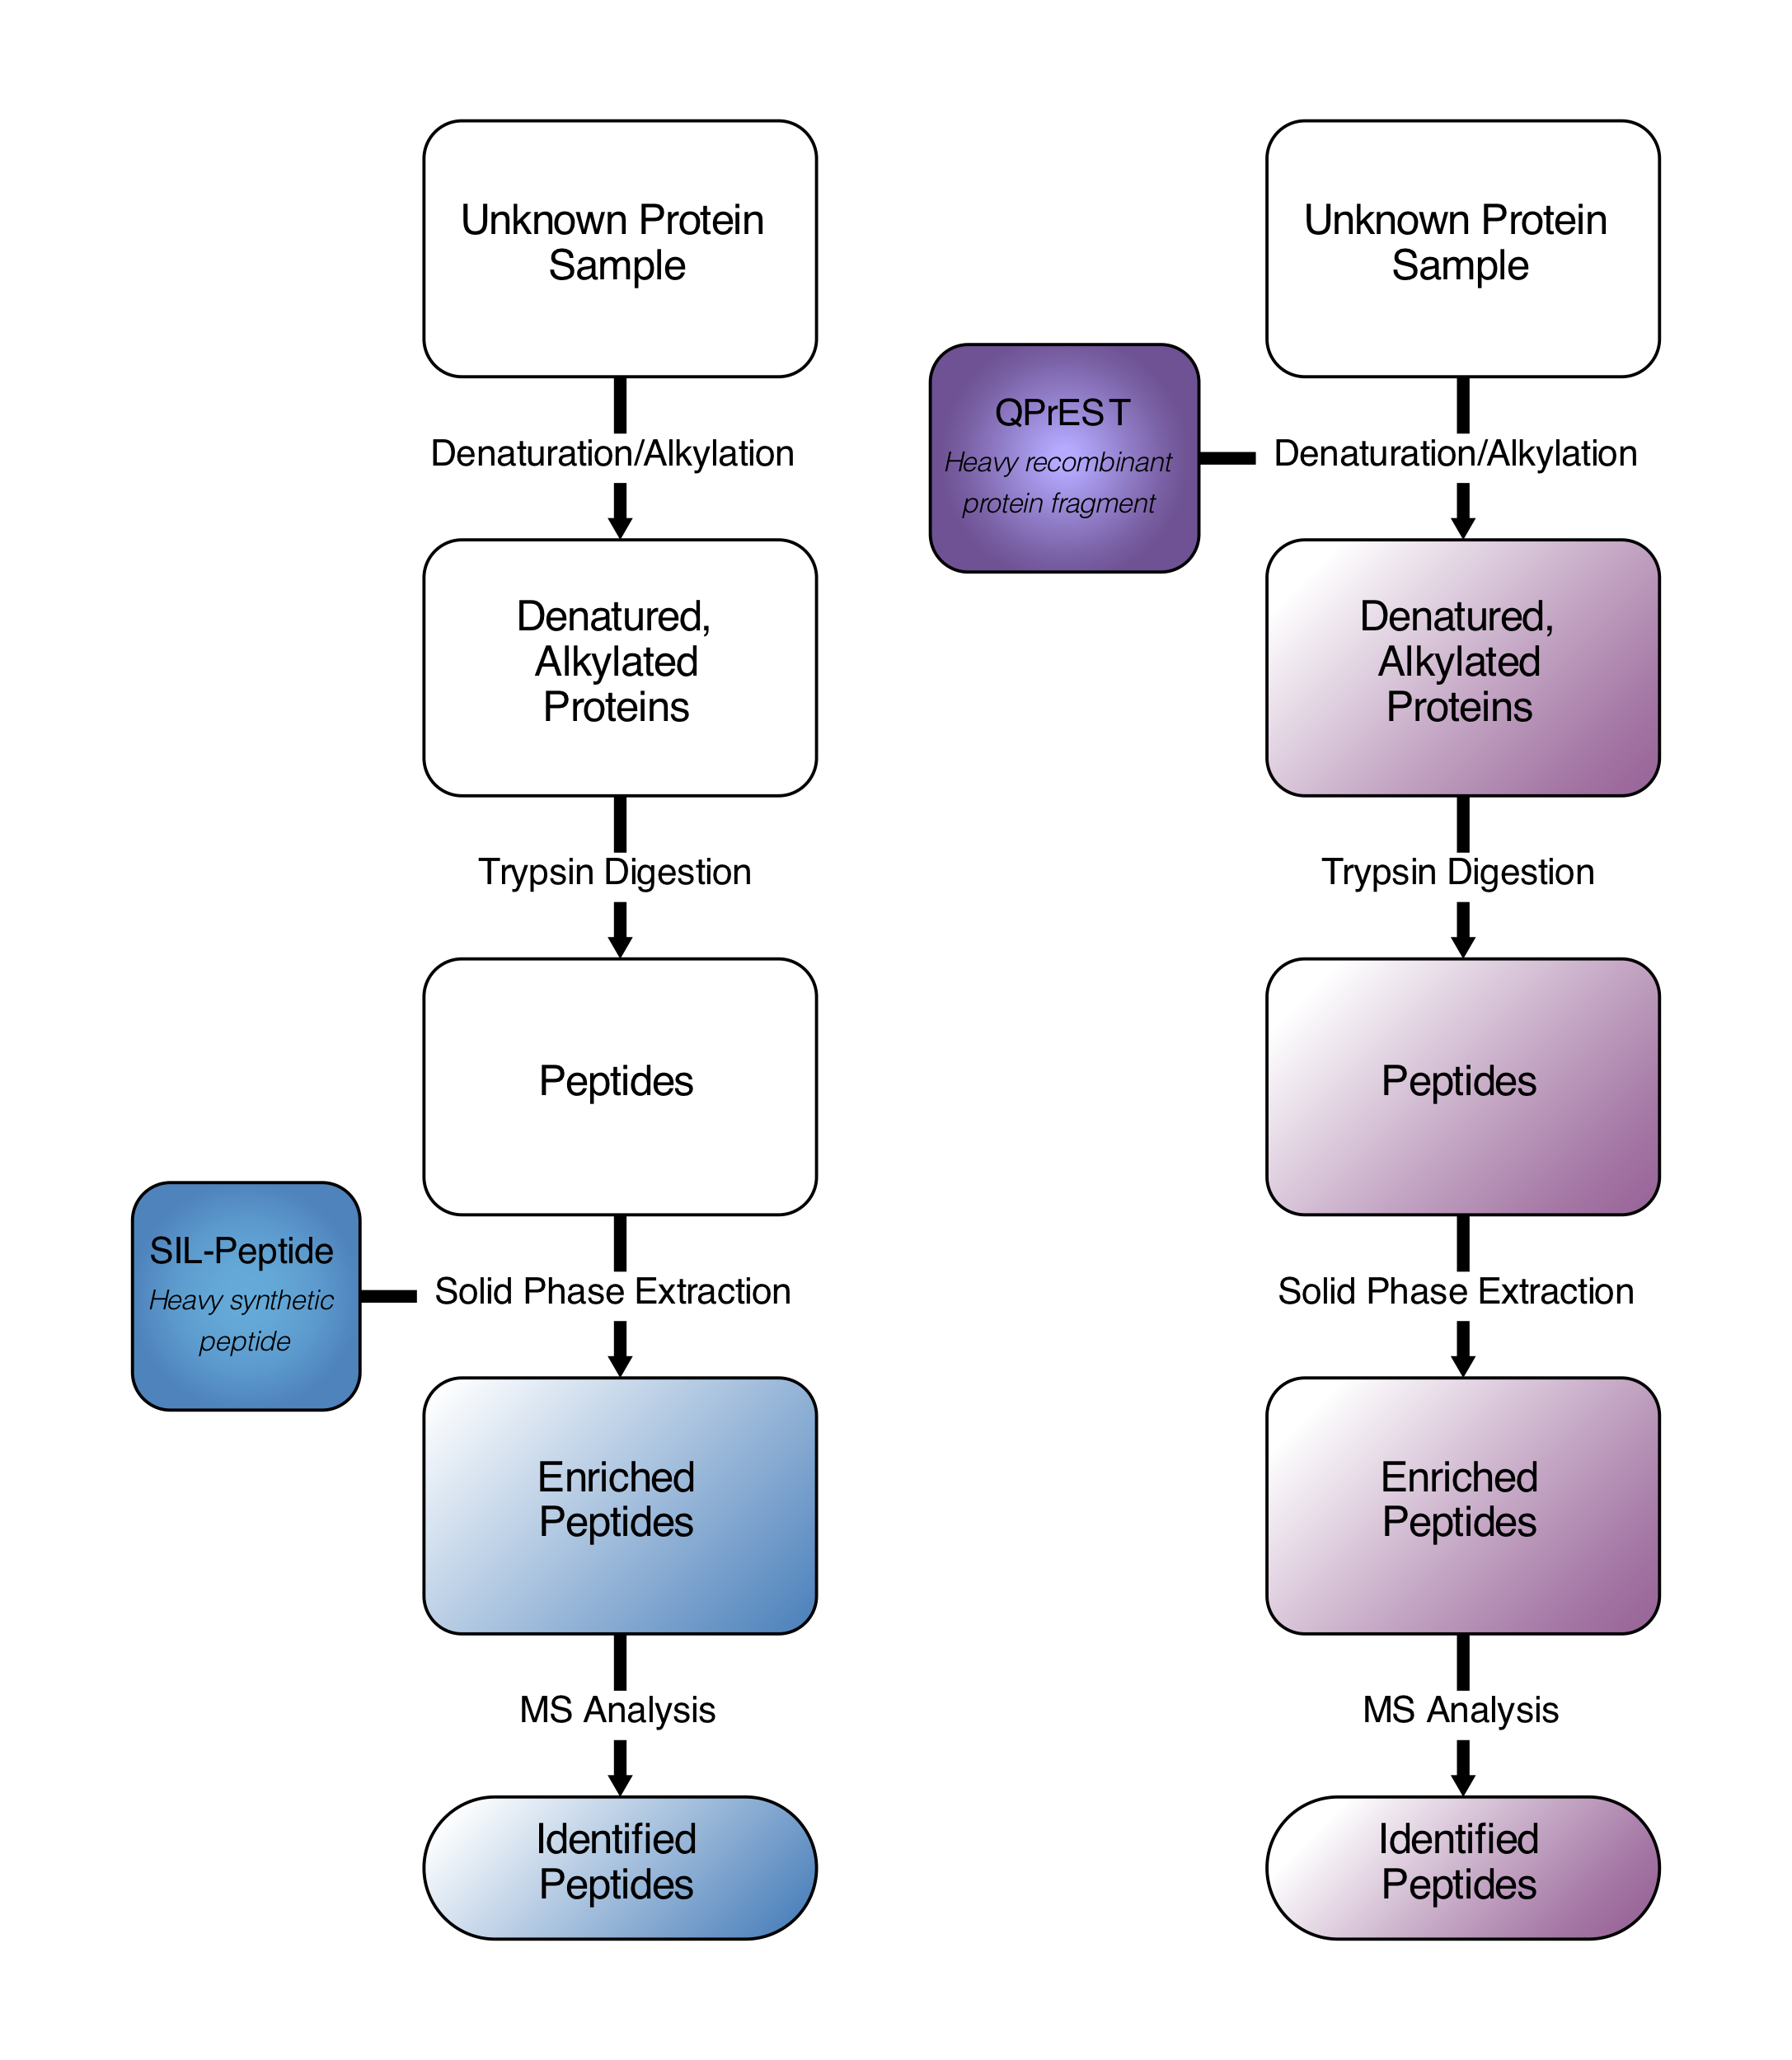
Stable isotope-labeled standards
Heavy versions of peptides or proteins
Labeled with stable isotopes to introduce a small mass shift
¹³C and ¹⁵N most common
Heavy Lys (+8 Da) or Arg (+10Da) most commonly used
Have identical physiochemical properties as the light peptide, e.g. retention time, ionization, fragmentation
Peptides
Chemical synthesis
Many kinds of modifications possible
Added late in the sample preparation
Proteins and protein fragments
Metabolic labeling during protein expression
Added early in the sample prep workflow
Are enzymatically digested together with the sample

Slide 24
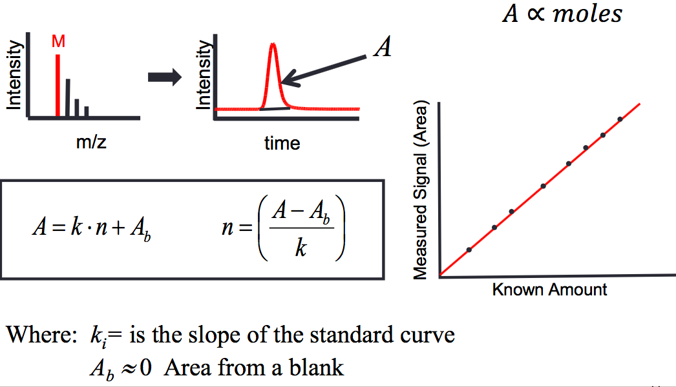
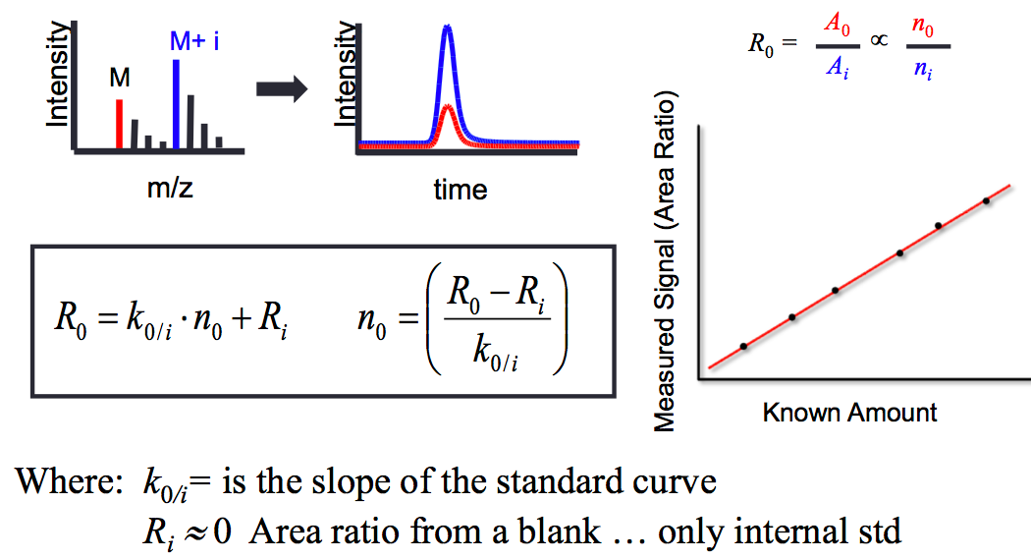
Quantification
Label free quantification
Analyte (m/z = M)
Quantification using isotope labeled standards
Sample (m/z = M).
Internal standard (m/z = M + i)

Slide 25
Accuracy and Precision
Accurate and precise
Precise, but not accurate
Accuracy
How close we are to the real concentration
Crucial when absolute quantities are needed
Precision
How reproducible the quantification is
Estimated by making replicate measurements
Coefficient of variation (CV)
Accurate, but not precise
Neither accurate nor precise

Slide 26
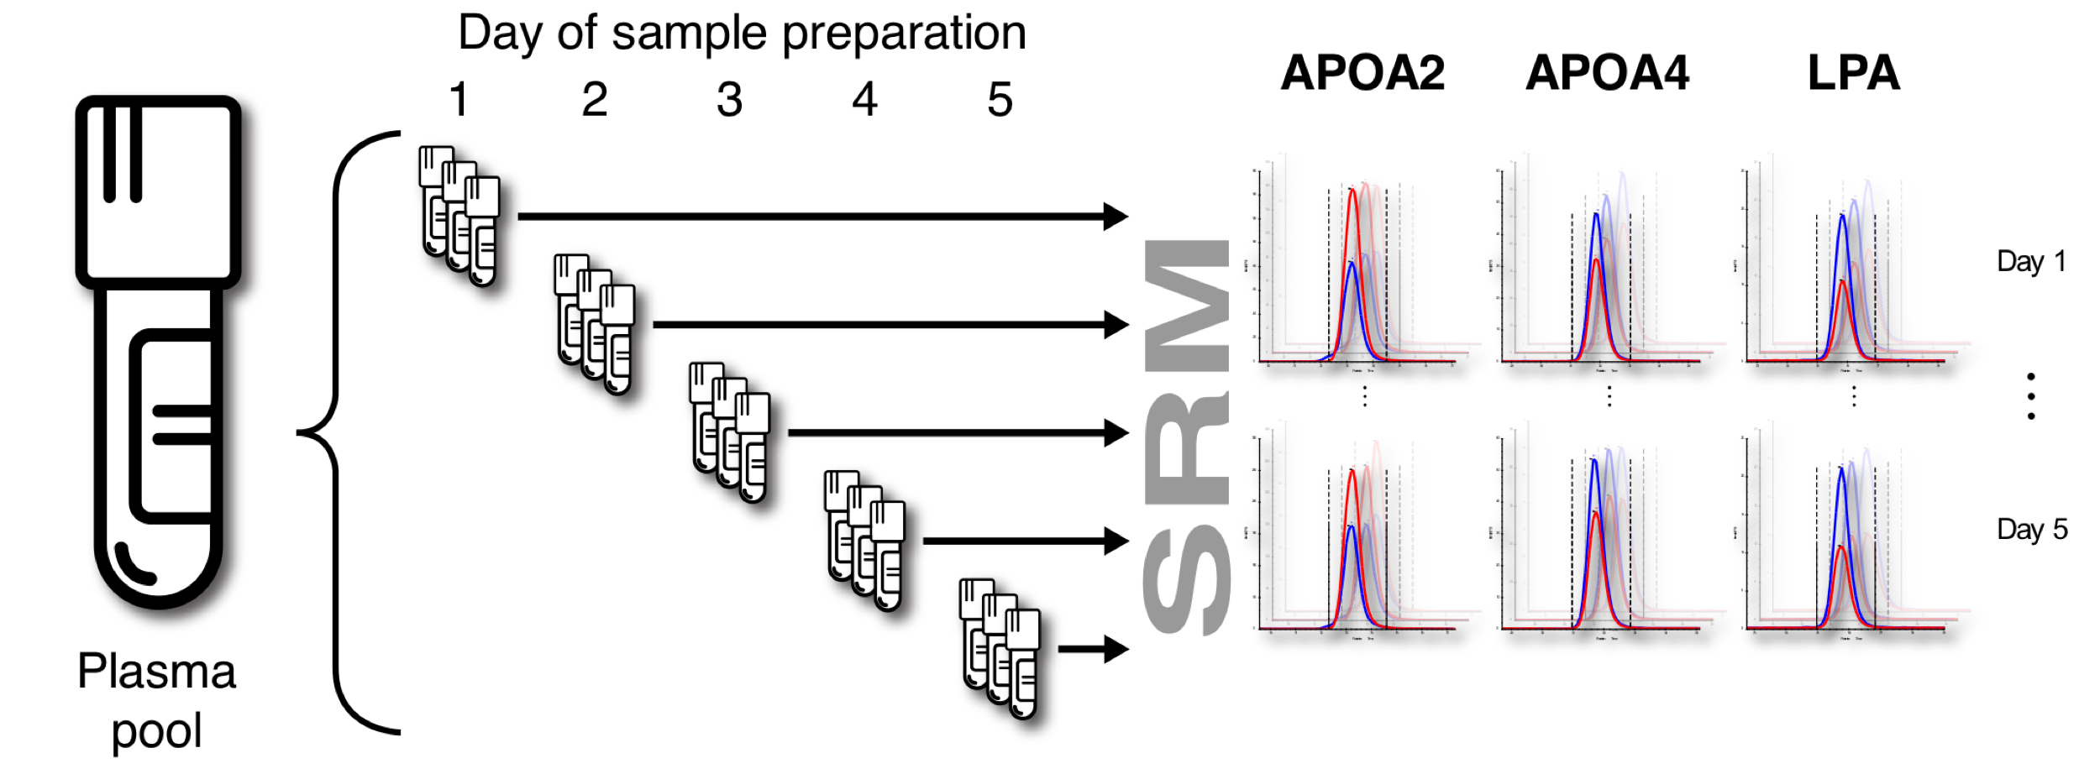
Assay validation – Apolipoprotein SRM

Slide 27
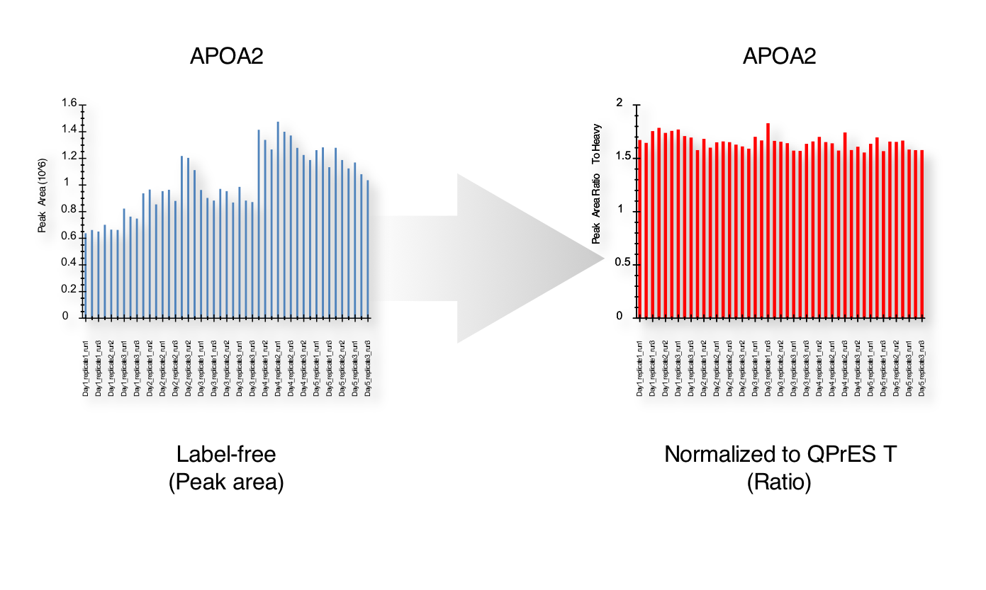
Assay validation – Apolipoprotein SRM
Label free
(Peak area)
Normalized to standard
(Peak area ratio)
Robustness across five days for 13 proteins
CV: 4.5-8.8 %
Median CV: 5.9 %
Label free CV: approx. 30 %

Slide 28
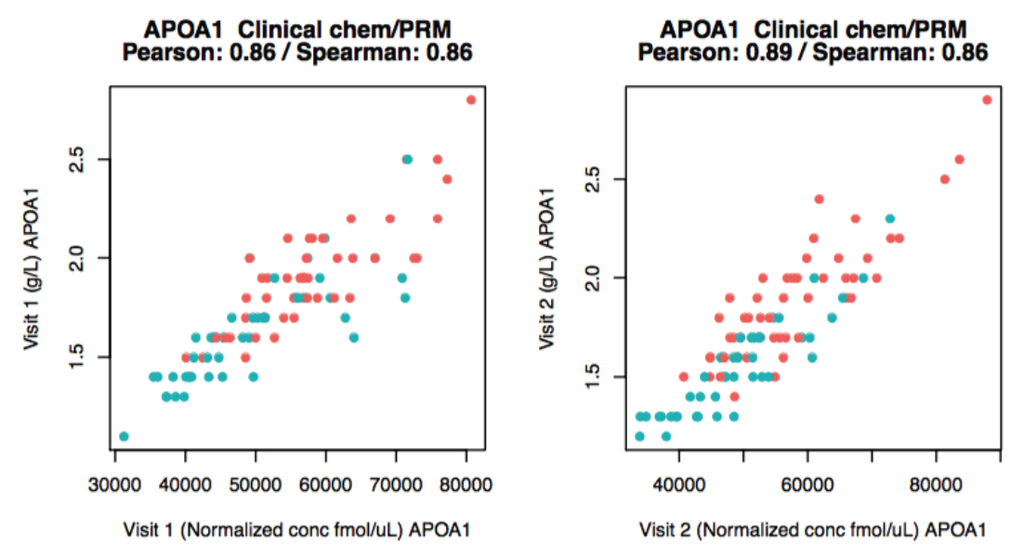
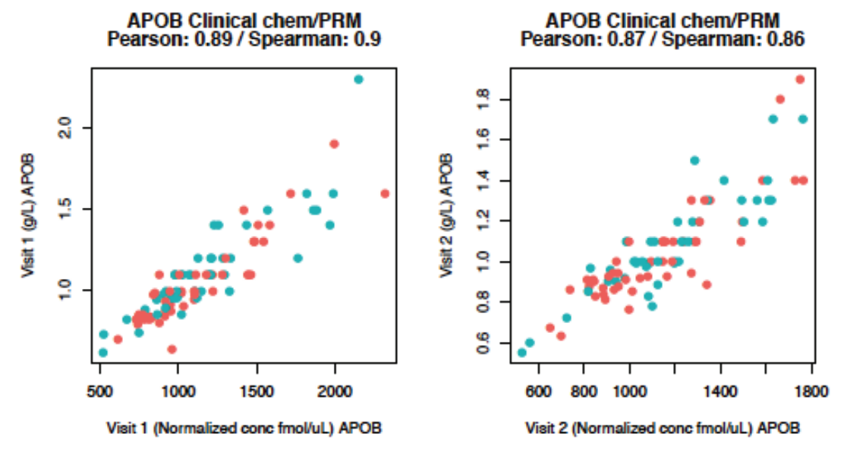
Assessing accuracy
Notes:
Good correlation with clinical chemistry done at in the hospital lab
Different scales: g/L vs. fmol/ul
APOA1: Great accuracy (provided the clinical assay is correct)
APOB: We seem to overestimate APOB by a factor of almost 2. Is this good accuracy? Dynamic range of plasma what we can detect in plasma is 4-5 orders of magnitude

Slide 29
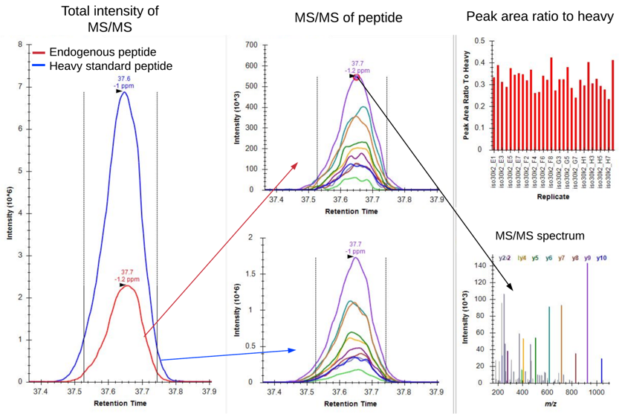
Targeted proteomics data analysis in Skyline
Add list of the analyzed peptides
Read raw data files
Integrate peaks (automatic)
Remove fragments with interference
Export peak areas or peak area ratio to standard if isotope labeled standards were used

Slide 30
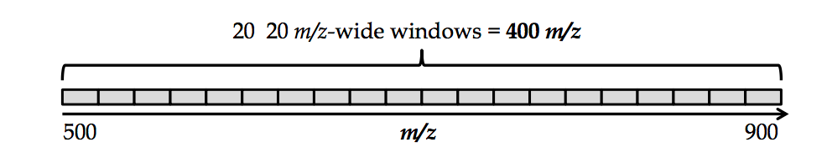
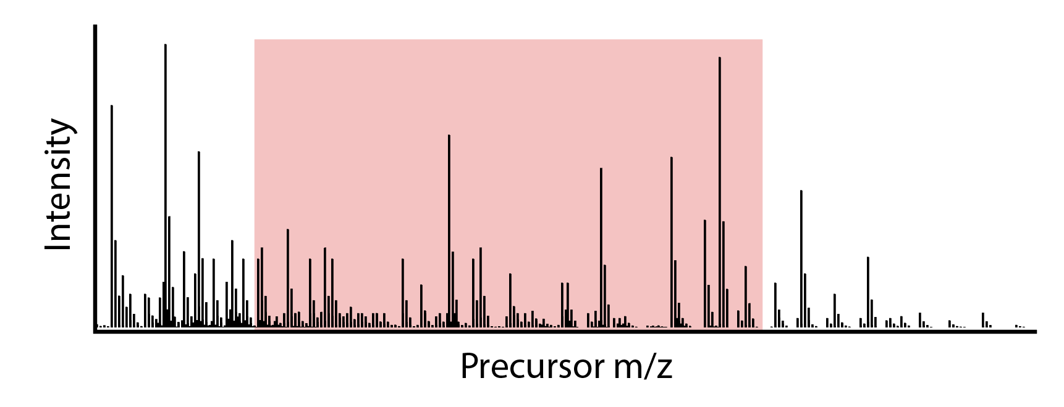
Data Independent Acquisition (DIA or SWATH)
DIA or Sequential Windowed Acquisition of all Theoretical Fragment Ion Mass Spectra (SWATH)
Measure all fragment ions for all precursors within a limited mass range
Can analyze thousands of peptides in MS2 in one single run
Need known fragmentation patterns and RT for data analysis
Notes:
So what if we have 1000’s rather than 50-100 proteins we want to quantify in MS2

Slide 31
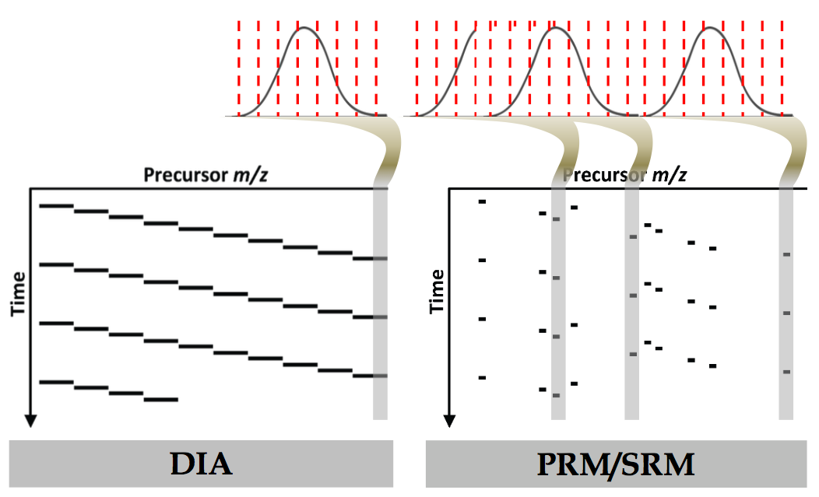
“SRM” on “All”
Precursor m/z
Precursor m/z
SWATH video - https://www.youtube.com/watch?v=VZAZtA_qEbg&feature=youtu.be&t=87

Slide 32
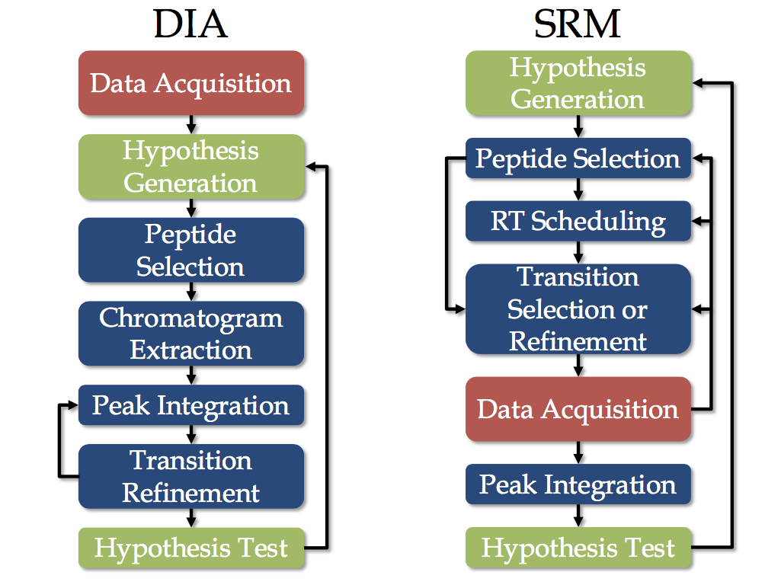
Advantages of DIA over SRM / PRM
DIA data analysis assays can be created after samples are run
Data can be re-analyzed at later stage when more assays are available
Can detect and quantify thousands of peptides (SRM approx. 100) in one run.
However, less sensitive than SRM

Slide 33
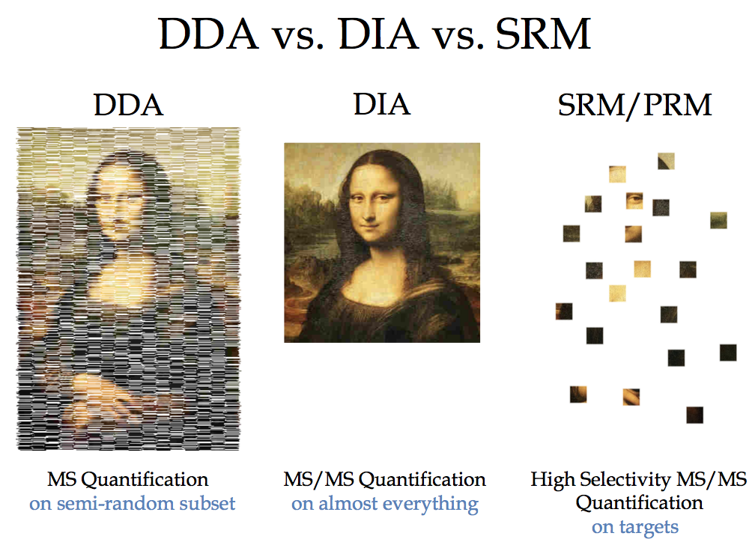
DDA vs DIA vs SRM

Slide 34
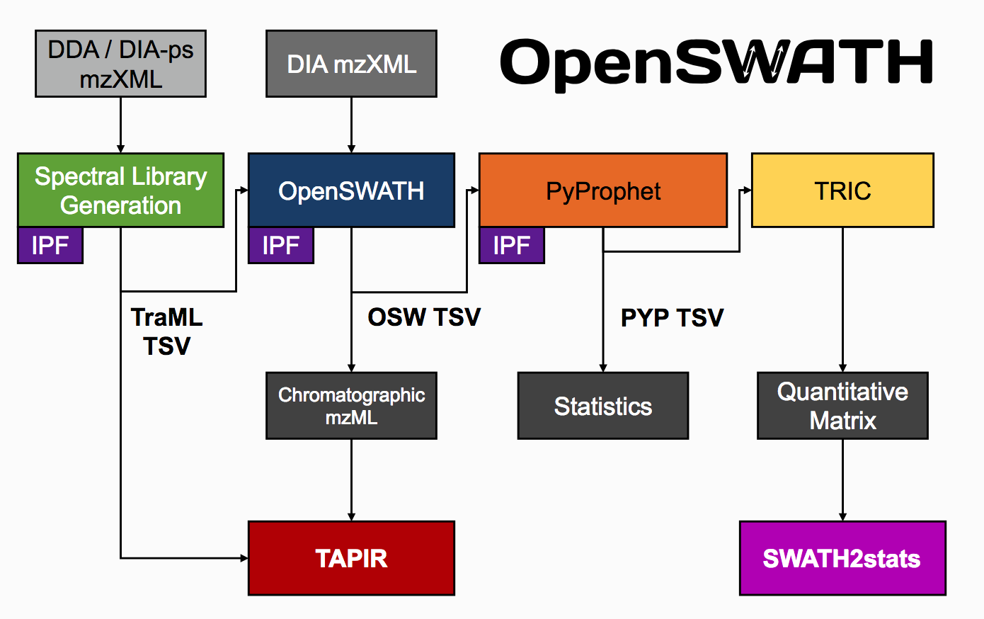
DIA data analysis
Need for spectral libraries to identify peptide peaks
Fragmentation spectra with relatative fragment intensities
Indexed Retention Time (iRT)
Statistical analysis to exclude miss identified peptides and proteins
http://www.openswath.org/en/latest/

Slide 35
Tissue based map of the human proteome

Slide 36
Classification of the human proteome

Slide 37
Analysis of Tissue elevated proteins

Slide 38
Generation of metabolic models

Slide 40
Proteomics and transcriptomics analysis of human tissues

Slide 41
Proteomics and transcriptomics expressions in human tissues

Slide 42
Correlations between Proteomics and transcriptomics expressions

